Slide 1
College Buddy(College Assisstant)
Our Team:
NAME | ROLLNO.
Abhay Singh | 1710991026
Abhinav Sharma | 1710991031
Abhinav Shroff | 1710991033

Slide 2
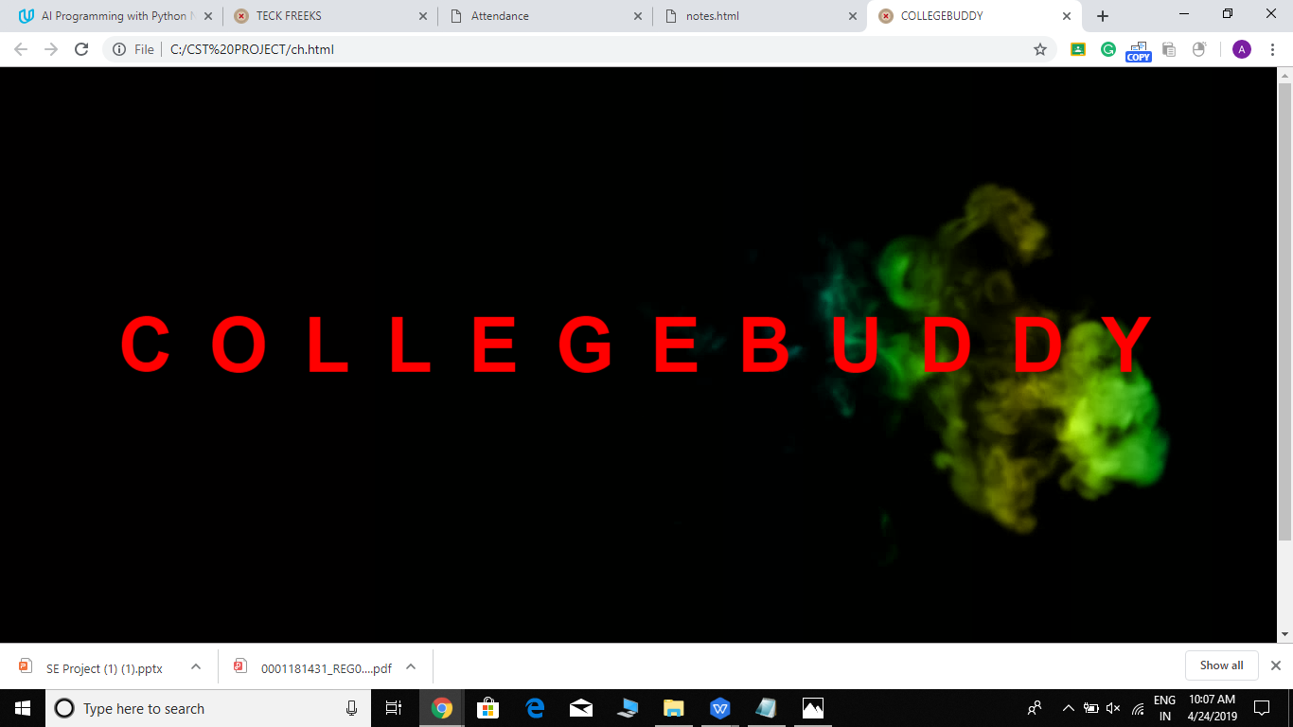
Intro:

Slide 3
Objective:
Our main objective is to make life easier for students.As Student already have to study and make projects so to just make their life a little easy we provide them their own personal college assistant.
From tracking your attendance to making your cv our college assistant can do all. No need to worry about notes as our assistant even provides access to your notes and if you want to help your friends you can also upload the notes.
Our goal is to give the students a medium through which they can help other students like providing notes and many more feature coming soon to make this community more strong.
Last but not least our college assisstant can also show you your time table,and will help you plan accordingly.

Slide 4
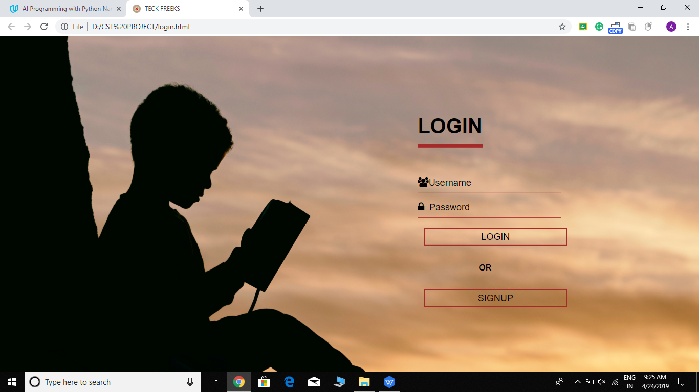
Login page:

Slide 5
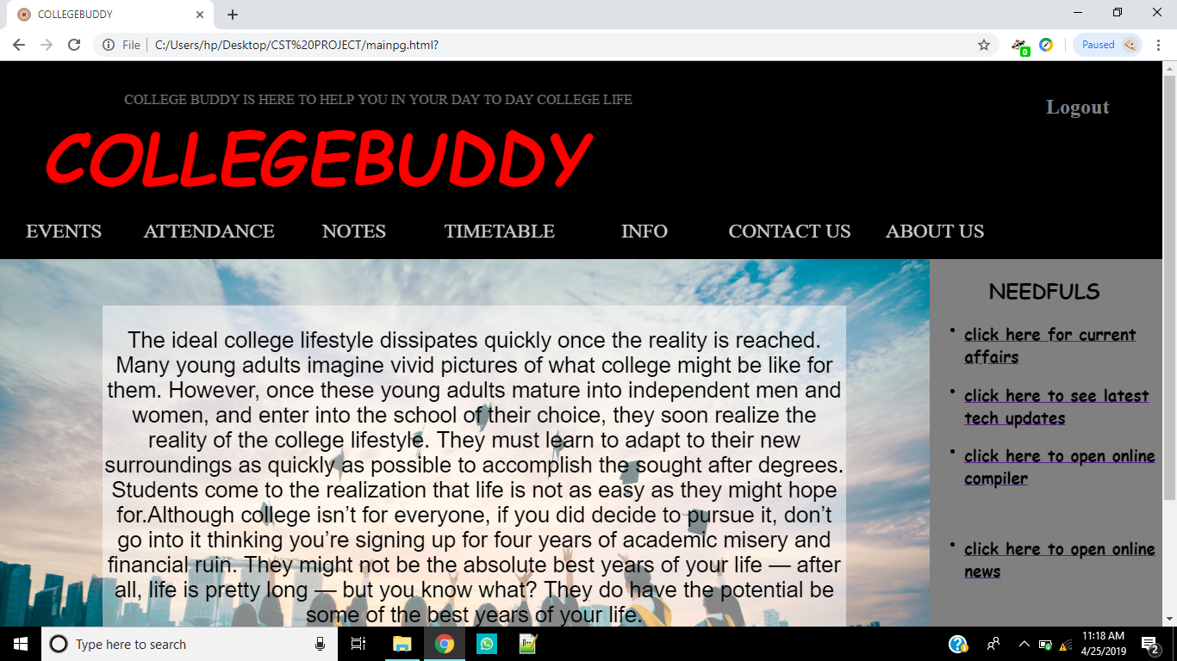
Main Page:

Slide 6
Overview
Main objective of our website is to help students in college.
Our website can do many tasks for the students.
Some of the tasks done by our website are :
It can keep the attendance of the user updated.
The student can even upload his/her notes to help other students.
It also shows you the time table of your lectures.
It can also help you to build your cv.

Slide 7
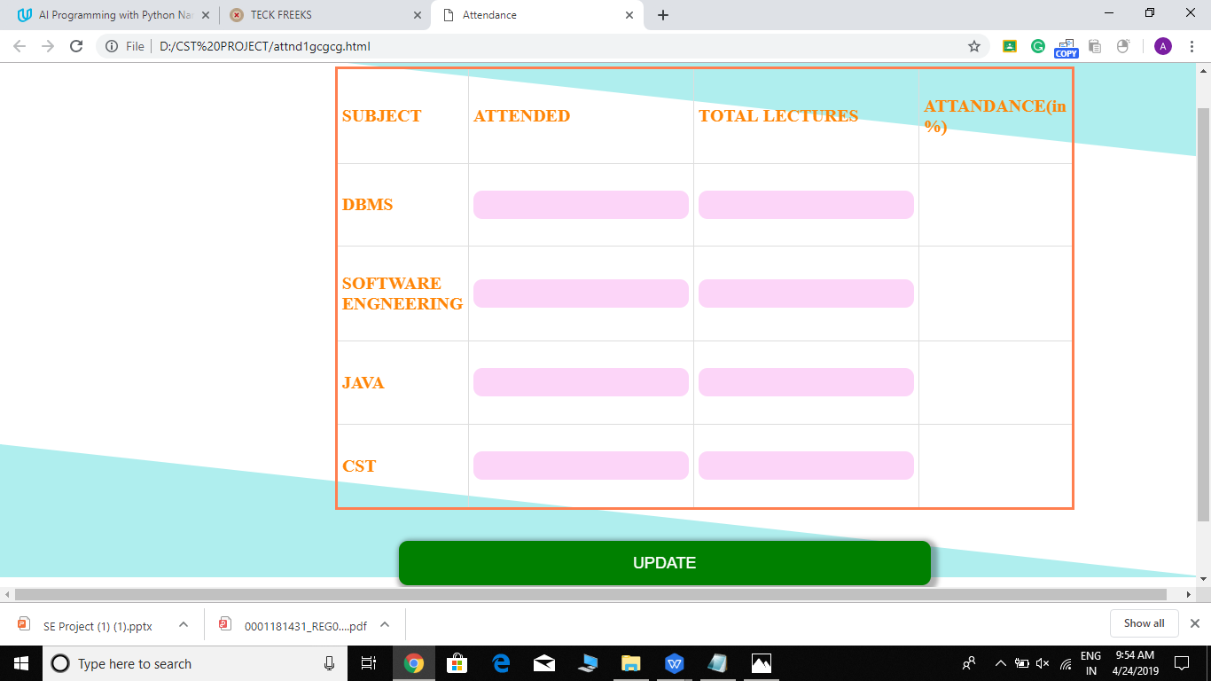
Keep Your Attendance Updated:

Slide 8
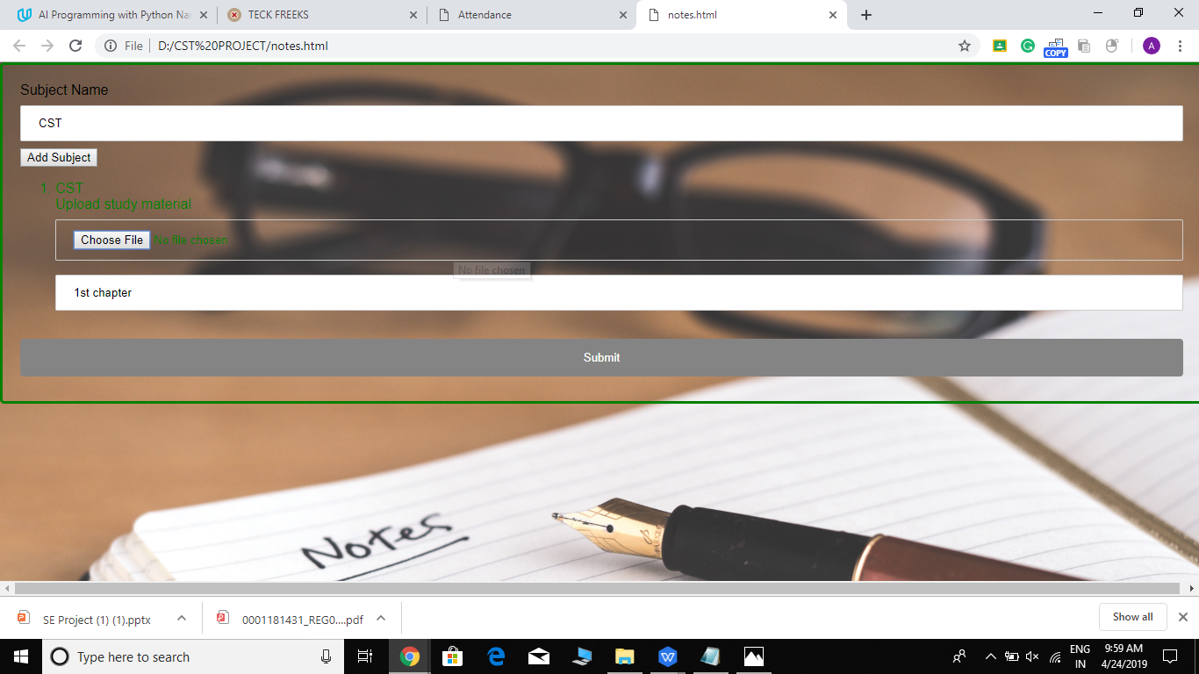
Upload Notes:

Slide 9
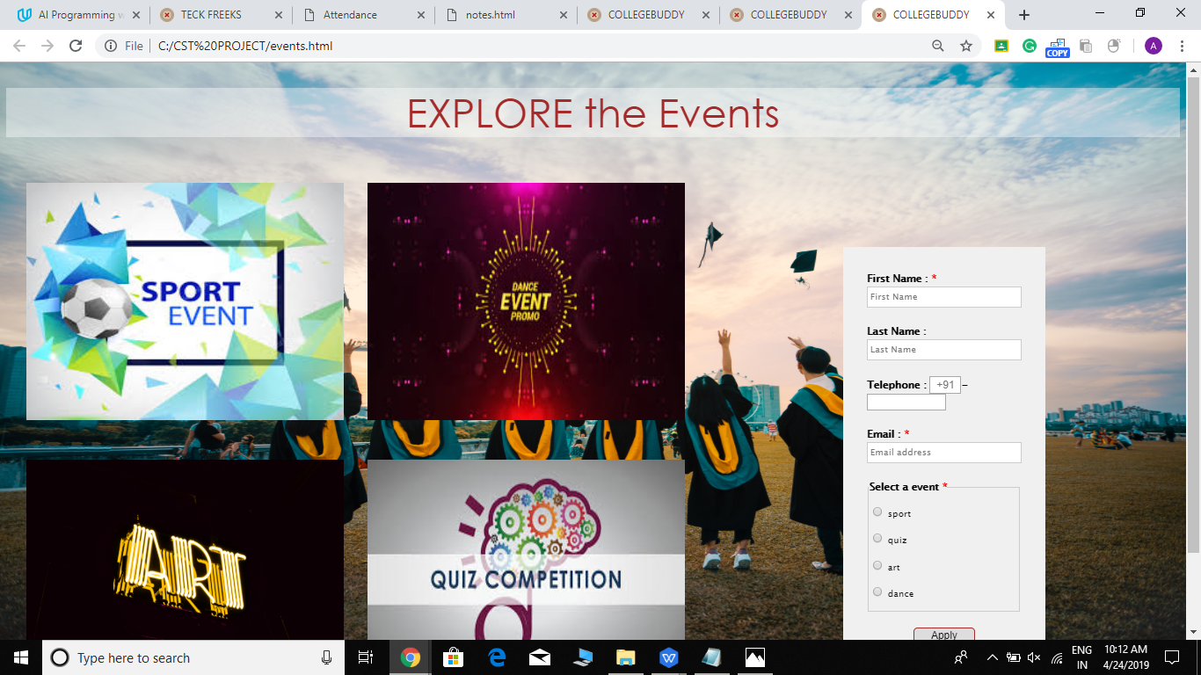
Register For Events:

Slide 10
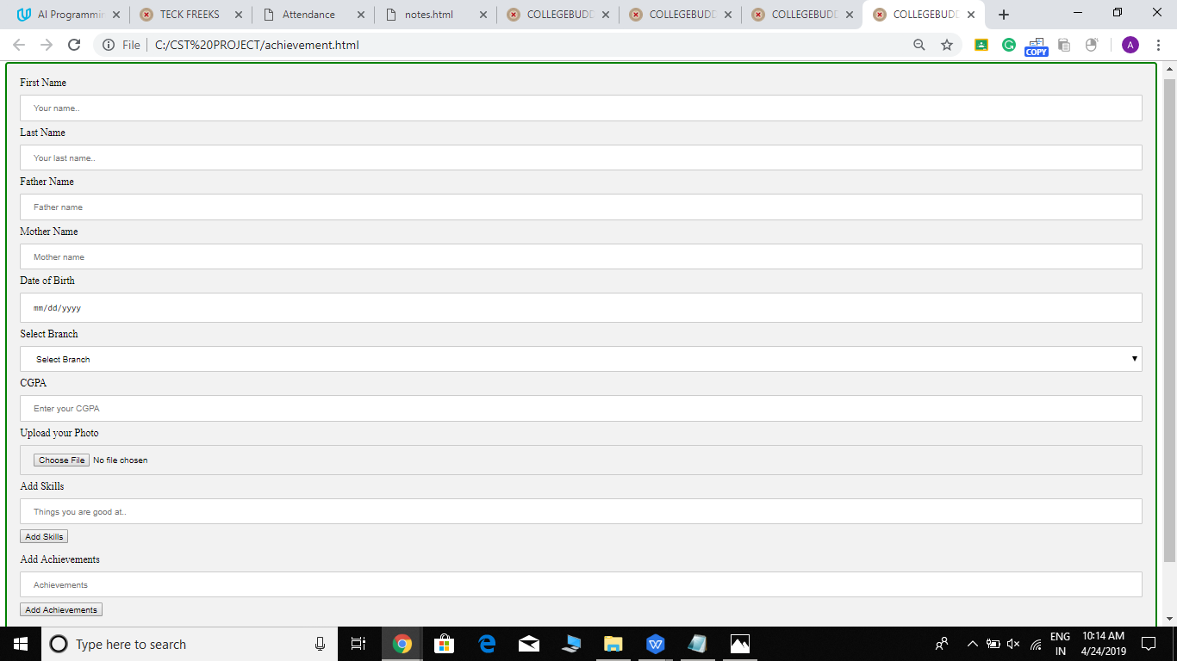
Make your own cv:

Slide 11
Conclusion
Our website is made to assist students and to make their life easier by helping them in tasks like uploading notes,maintaining attendance and many more.
Through this website student get a way to help other students by uploading notes.
Our website also helps student to create their own cv.
At the end our main objective is to make a website which is student friendly ,easy to use and which could help students in a good way.
We hope to add many new features to help students in coming future.

Slide 12
Future Goals
Adding a feature to maintain CV of the candidate taking data from personal information.
Feature that will remind students in case of shortage of attendance and also about new upcoming events.
Adding themes to website.

